Slide 1
UNIT – IV
Designing user interface using views
(10 hrs -12 Marks)

Slide 2
Text view attributes
android:id
This is the ID which uniquely identifies the control.
android:capitalize
If set, specifies that this TextView has a textual input method and should automatically capitalize what the user types.
Don't automatically capitalize anything - 0
Capitalize the first word of each sentence - 1
Capitalize the first letter of every word - 2
Capitalize every character - 3

Slide 3
android:text
Text to display.
android:textColorHighlight
Color of the text selection highlight.
android:textSize
Size of the text.
android:textStyle
Style (bold, italic, bolditalic) for the text.
android:drawableStart="@drawable/ic_lappy"
Android also allows adding drawable with the text views.
There are three positions to add the icons for the TextView. They are a start, end, top, and bottom.
android:autoLink
Controls whether links such as urls and email addresses are automatically found and converted to clickable links.
Android:alpha:
alpha property of the view as a value between 0 (entirely transparent) and 1(Completely Opaque).

Slide 4
TextColor: textColor attribute is used to set the text color of a text view. Color value is in the form of
Eg : <android:textColor="#f00"/><!--red color for text view-->
Color.xml :
<color name="white">#FFFFFF</color>
<color name="yellow">#FFFF00</color>
<color name="fuchsia">#FF00FF</color>
<color name="red">#FF0000</color>
<color name="silver">#C0C0C0</color>
<color name="gray">#808080</color>

Slide 5
Text size - units
Density independence (dp)- “density independence” it preserves the physical size (from the user’s point of view) of user interface elements when displayed on screens (ie). one dp is one pixel
The image should look the same size in different types of screens.
Scale-independent Pixels (sp)
- this is like the dp unit, but it is also scaled by the user's font size preference.
It is recommended you use this unit when specifying font sizes,
Then only the font inside the application will change while device fonts size changes
If you want to keep a static sized font inside the app, you can give the font dimension in dp. In such a case, it will never change. In all other cases, sp is recommended.

Slide 6
Sample example of TextView
TextView code in XML:
<TextView android:id="@+id/simpletextview" android:layout_width="wrap_content" android:layout_height="wrap_content"
/>
TextView code in JAVA:
TextView textView1 = (TextView) findViewById(R.id.simpletextview); textView1.setText("AbhiAndroid"); //set text for text view
textView1.setTextColor(Color.RED); //set red color for text view
textView1.setTextSize(20); //set 20sp size of text
textView1.setBackgroundColor(Color.BLACK);//set background color

Slide 7
change the text on button click event activity_main.xml
<RelativeLayout xmlns:android="http://schemas.android.com/apk/res/android" xmlns:tools="http://schemas.android.com/tools" android:layout_width="match_parent" android:layout_height="match_parent“
<TextView android:id="@+id/simpleTextView" android:layout_width="wrap_content" android:layout_height="wrap_content" android:layout_centerHorizontal="true" android:text="Before Clicking" android:textColor="#f00" android:textSize="25sp" android:textStyle="bold|italic" android:layout_marginTop="50dp"/>
<Button android:id="@+id/button
" android:layout_width="wrap_content" android:layout_height="wrap_content“
android:text="Change Text" / >
</RelativeLayout>

Slide 8
change the text on button click event MainActivity.java
public class MainActivity extends AppCompatActivity {
@Override
TextView simpleTextView = (TextView) findViewById(R.id.simpleTextView); //get the id for TextView
Button changetext= (Button) findViewById(R.id.button); //get the id for button
changeText.setOnClickListener(new View.OnClickListener() { @Override
public void onClick(View view) {
simpleTextView.setText("After Clicking"); //set the text after clicking button
} });
} }

Slide 9
Edit Text Attributes
android:autoText
If set, specifies that this TextView has a textual input method and automatically corrects some common spelling errors.
2android:drawableBottom
This is the drawable to be drawn below the text.
3android:drawableRight
This is the drawable to be drawn to the right of the text.
Android:maxlength=5
Set maximum length
android:digits="012345“
to accept numeric only.

Slide 10
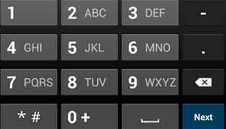
Edit Text
Attributes:<input type>
specify the input type for each
text field in your app so the
system displays the appropriate
soft input method
(such as an on-screen keyboard).
Eg : android:inputType="phone"
android:inputType="text"

Slide 11
Java source code to set and get text
Set the Text of Android EditText
EditText et = (EditText)findViewById(R.id.editText1); et.setText("Welcome to Tutlane");
Get Text of Android EditText
EditText et = (EditText) findViewById(R.id.txtSub); String name = et.getText().toString();

Slide 12
.Java code to insert EditText in layout
public class MainActivity extends AppCompatActivity { @Override protected void onCreate(Bundle savedInstanceState) { super.onCreate(savedInstanceState); setContentView(R.layout.activity_main);
LinearLayout linearLayout 1= (LinearLayout) findViewById(R.id.linearlayout); EditText et = new EditText(this); et.setHint("Subject"); linearLayout1.addView(et); } }

Slide 13
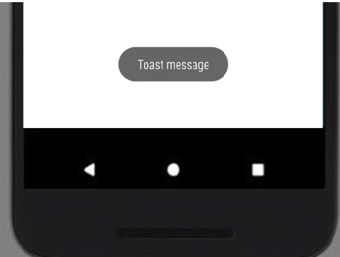
Toast
Toast class is used to show notification for a particular interval of time. After sometime it disappears. It doesn't block the user interaction.
Use the makeText() method, which takes the following parameters:
The application Context.
The text that should appear to the user.
The duration that the toast should remain on the screen.

Slide 14
Toast class
Toast class is used to show notification for a particular interval of time. After sometime it disappears. It doesn't block the user interaction.
Methods :
. makeText( ); makes the toast containing text and duration.
. show( ); displays toast.
. setMargin( ); changes the horizontal and vertical margin difference.
Example :
Toast.makeText(getApplicationContext(),"Hello",Toast.LENGTH_SHORT).show();
LENGTH_LONG : displays view for the long duration of time.
LENGTH_SHORT : displays view for the short duration of time.

Slide 15
Android Programming Context : give us the Context of the current state of our application.
It allows us to access resources.
It allows us to interact with other Android components by sending messages.
It gives you information about your app environment.
Two types :
1. Application Context : This Context is tied to the Lifecycle of an Application.
It is used to return the Context which is linked to the Application which holds all activities running inside it.
getApplicationContext() : to pass the application Context.
2. Activity Context :
It returns the Context which is linked to the Activity from which it is called.
getContext(): This is useful when we want to call the Context from only the current running activity.
We can use : MyActivity.this , this

Slide 16
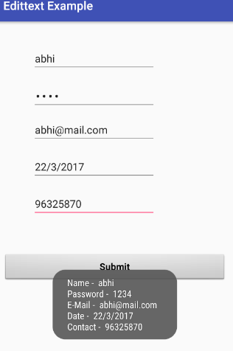
EditText example ….
get the value from multiple edit texts and on button click event the Toast will show the data defined in Edit text.

Slide 17
<RelativeLayout xmlns:android="http://schemas.android.com/apk/res/android" xmlns:tools="http://schemas.android.com/tools" android:id="@+id/activity_main" android:layout_width="match_parent" android:layout_height="match_parent“
<EditText android:id="@+id/editText1" android:layout_width="wrap_content" android:layout_height="wrap_content“
android:layout_alignParentLeft="true“ android:layout_alignParentTop="true“
android:layout_marginLeft="50dp“
android:layout_marginTop="24dp”
android:hint="@string/name"
android:inputType="text“
android:selectAllOnFocus="true" />

Slide 18
<EditText android:id="@+id/editText2" android:layout_width="wrap_content" android:layout_height="wrap_content" android:layout_alignLeft="@+id/editText1" android:layout_alignStart="@+id/editText1" android:layout_below="@+id/editText1" android:layout_marginTop="19dp"
android:hint="@string/password_0_9" android:inputType="numberPassword" />
<EditText android:id="@+id/editText3" android:layout_width="wrap_content" android:layout_height="wrap_content" android:layout_alignLeft="@+id/editText2" android:layout_alignStart="@+id/editText2" android:layout_below="@+id/editText2" android:layout_marginTop="12dp"
android:hint="@string/e_mail"
android:inputType="textEmailAddress" />

Slide 19
<EditText android:id="@+id/editText4" android:layout_width="wrap_content" android:layout_height="wrap_content" android:layout_alignLeft="@+id/editText3" android:layout_alignStart="@+id/editText3" android:layout_below="@+id/editText3" android:layout_marginTop="18dp"
android:hint="@string/date" android:inputType="date" />
<EditText android:id="@+id/editText5" android:layout_width="wrap_content" android:layout_height="wrap_content" android:layout_alignLeft="@+id/editText4" android:layout_alignStart="@+id/editText4" android:layout_below="@+id/editText4" android:layout_marginTop="18dp“ android:hint="@string/contact_number“
android:inputType="phone" />

Slide 20
<Button android:id="@+id/button" android:layout_width="match_parent" android:layout_height="wrap_content"
android:layout_below="@id/editText5" android:layout_marginTop="62dp" android:text="@string/submit"
android:textSize="16sp“
android:textStyle="normal|bold" /> </RelativeLayout>

Slide 21
MainActivity.java code
public class MainActivity extends AppCompatActivity { Button submit;
EditText name, password, email, contact, date;
@Override
protected void onCreate(Bundle savedInstanceState) { super.onCreate(savedInstanceState); setContentView(R.layout.activity_main);
name = (EditText) findViewById(R.id.editText1);
password = (EditText) findViewById(R.id.editText2);
email = (EditText) findViewById(R.id.editText3);
date = (EditText) findViewById(R.id.editText4);
contact = (EditText) findViewById(R.id.editText5);
submit = (Button) findViewById(R.id.button);

Slide 22
submit.setOnClickListener(new View.OnClickListener() {
@Override
public void onClick(View v)
{ if (name.getText().toString().isEmpty() || password.getText().toString().isEmpty() || email.getText().toString().isEmpty() || date.getText().toString().isEmpty() || contact.getText().toString().isEmpty()) {
Toast.makeText(getApplicationContext(), "Enter the Data", Toast.LENGTH_SHORT).show(); }
else { Toast.makeText(getApplicationContext(), "Name - " + name.getText().toString() + " \n" +
"Password - " + password.getText().toString() + " \n" +
"E-Mail - " + email.getText().toString() + " \n" +
"Date - " + date.getText().toString() + " \n" +
"Contact - " + contact.getText().toString(), Toast.LENGTH_SHORT).show(); }

Slide 23
Else {
str= "Name - " + name.getText().toString() + " \n" +
"Password - " + password.getText().toString() + " \n" +
"E-Mail - " + email.getText().toString() + " \n" +
"Date - " + date.getText().toString() + " \n" +
"Contact - " + contact.getText().toString()
Toast.makeText(getApplicationContext(), str , Toast.LENGTH_SHORT).show();
}

Slide 24
AutoCompleteText View
AutocompleteTextView is an editable text view that shows completion suggestions automatically while the user is typing in android apps.
AutoCompleteTextView is a component used to show suggestions while writing in an editable text field.
The suggestions list is shown in a drop down menu from which a user can select the desired item.
The list of suggestions is obtained from an adapter and it appears only after a number of characters that are specified in the threshold.
ArrayAdapter In Android:
ArrayAdapter is used when we need list of items. For example, list of phone contacts, countries or names.

Slide 25
AutoCompleteTextView Attributes
1.android:completionHint
Hint text displayed at the bottom of the matching list 2.android:completionHintView
This defines the hint view displayed in the drop down menu.
3.android:completionThreshold
This defines the number of characters that the user must type before completion suggestions are displayed in a drop down menu.
Note : If not set then suggestion will not be display.
4.android:dropDownAnchor
This is the View to anchor the auto-complete dropdown list. Drop down must appear below the anchor view.
Eg: android:dropDownAnchor="@id/txt_countries“
<Text View android:id=“@id/txt_countries”
android:text=“Select Countries” />
5.android:dropDownHeight
This specifies the basic height of the dropdown.
6.popupBackground : Set back color of list.

Slide 26
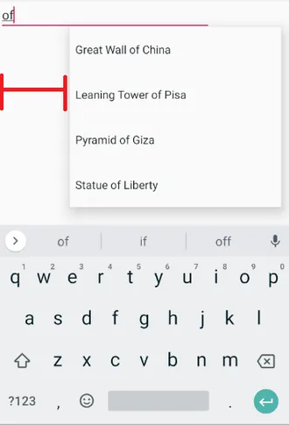
android:dropDownHorizontalOffset Amount of pixels by which the drop down should be offset horizontally.
Eg : android:dropDownHorizontalOffset="100dp"

Slide 27
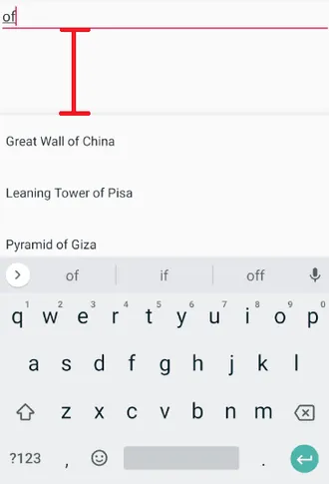
android:dropDownVerticalOffset Amount of pixels by which the drop down should be offset vertically.

Slide 28
Methods
getAdapter() : This method returns a filterable list adapter used for auto completion
setAdapter(): setting the adapter data into the AutoCompleteTextView
getCompletionHint() : This method returns optional hint text displayed at the bottom of the matching list
id for the view that the auto-complete drop down list is attached to
getListSelection() : This method returns the position of the dropdown view selection, if there is any
To get value of selected item:
Eg : String.valueOf(adpt.getListSelection);

Slide 29
Example:
<RelativeLayout xmlns:android="http://schemas.android.com/apk/res/android" xmlns:tools="http://schemas.android.com/tools" android:layout_width="match_parent" android:layout_height="match_parent" tools:context=".MainActivity"> <TextView android:id="@+id/textView" android:layout_width="wrap_content" android:layout_height="wrap_content" android:layout_alignParentLeft="true" android:layout_alignParentTop="true" android:layout_marginTop="15dp" android:text="Name a fruit from (Apple Banana Cherry Date Grape Kiwi Mango Pear)" />

Slide 30
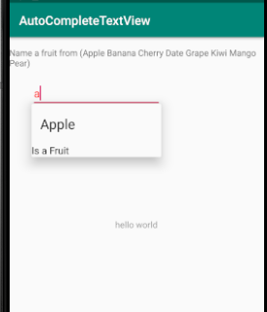
<AutoCompleteTextView android:id="@+id/autoCompleteTextView" android:layout_width="wrap_content" android:layout_height="wrap_content" android:layout_alignParentLeft="true" android:layout_below="@+id/textView" android:layout_marginLeft="36dp" android:layout_marginTop="17dp“
android:completionhint=“Is a Fruit”
android:text=""> </AutoCompleteTextView> </RelativeLayout>

Slide 31
MainActivity.java code
public class MainActivity extends AppCompatActivity { String[] fruits = {"Apple", "Banana", "Cherry", "Date", "Grape", "Kiwi", "Mango", "Pear"}; @Override protected void onCreate(Bundle savedInstanceState) { super.onCreate(savedInstanceState); setContentView(R.layout.activity_main);
//Creating the instance of ArrayAdapter containing list of fruit names
ArrayAdapter<String> adapter 1= new ArrayAdapter<String> (this,android.R.layout.select_dialog_item, fruits);
// select_dialog_item is the list style = display list above auto complete
//simple_list_item_1 = display list below auto complete
//Getting the instance of AutoCompleteTextView AutoCompleteTextView autotext= (AutoCompleteTextView) findViewById(R.id.autoCompleteTextView);
autotext.setThreshold(1);//will start working from first character autotext.setAdapter(adapter1); //setting the adapter data into the AutoCompleteTextView autotext.setTextColor(Color.RED); } }

Slide 32
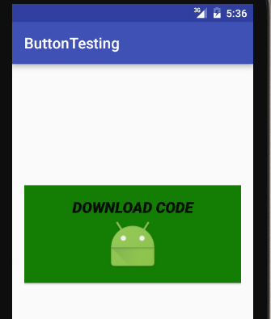
Button
drawableBottom: drawableBottom is the drawable to be drawn below of the text.
Eg :<!--image drawable on bottom-->
Android:text=“downloadcode”
<Button
android:drawableBottom=
"@drawable/ic_launcher"/>
<!--image drawable on Right side >
<Button
android:drawableRight=
"@drawable/ic_launcher"/>

Slide 33
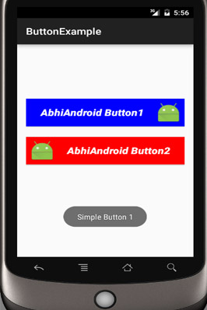
Button Example…
display two buttons with different background and whenever a user click on the button the text of the button will be displayed in a toast.

Slide 34
<Button android:id="@+id/simpleButton1" android:layout_width="fill_parent" android:layout_height="wrap_content" android:layout_centerHorizontal="true" android:layout_marginTop="100dp"
android:drawableRight="@drawable/ic_launcher" android:text="AbhiAndroid Button1" / >
<Button android:id="@+id/simpleButton2" android:layout_width="fill_parent" android:layout_height="wrap_content" android:layout_centerInParent="true“ android:drawableLeft="@drawable/ic_launcher" android:text="AbhiAndroid Button2“ />

Slide 35
MainActivity.java button example
public class MainActivity extends AppCompatActivity {
Button simpleButton1, simpleButton2;
@Override protected
void onCreate(Bundle savedInstanceState) { super.onCreate(savedInstanceState); setContentView(R.layout.activity_main);
simpleButton1 = (Button) findViewById(R.id.simpleButton1);//get id of button 1
simpleButton2 = (Button) findViewById(R.id.simpleButton2);//get id of button 2
simpleButton1.setOnClickListener(new View.OnClickListener() {
@Override
public void onClick(View view) {
Toast.makeText(getApplicationContext(), "Simple Button 1", Toast.LENGTH_LONG).show(); //display the text of button1
} });
simpleButton2.setOnClickListener(new View.OnClickListener() {
@Override
public void onClick(View view) {
Toast.makeText(getApplicationContext(), "Simple Button 2", Toast.LENGTH_LONG).show(); //display the text of button2 }

Slide 36
Student login –Check username and password
public class MainActivity extends AppCompatActivity {
Button login; TextView username , password;
@Override protected
void onCreate(Bundle savedInstanceState) { super.onCreate(savedInstanceState); setContentView(R.layout.activity_main);
login = (Button) findViewById(R.id.btn);
username = (TextView) findViewById(R.id.txt1);
password = (TexView) findViewById(R.id.txt2);
Login.SetOnClicklistner(new View.SetOnClicklistner() {
@Override
Public void onclick(View v) {
u= username.getText.toString();
p=username.getText().toString();
If(u.equals(“ABC”) && p.equal(“abc@123”)) {
Toast.makeText(getApplicationContext(), “Login Successfull", Toast.LENGTH_LONG).show(); }
Else {
Toast.makeText(getApplicationContext(), “Login UnSuccessfull", Toast.LENGTH_LONG).show(); }
}
});
}}

Slide 37
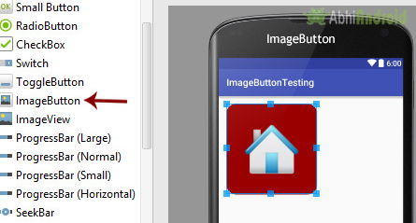
Image Button
Is a button with an image that can be pressed or clicked by the users. By default it looks like a normal button with the standard button background image is displayed in background.
<ImageButton
android:id="@+id/simpleImageButton" android:layout_width="wrap_content" android:layout_height="wrap_content"
android:src="@drawable/home" />.

Slide 38
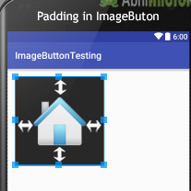
<ImageButton
android:id="@+id/simpleImageButton"
android:layout_width="wrap_content"
android:layout_height="wrap_content"
android:src="@drawable/home"
android:background="#000"/><!-- black background color for image button-->
android:padding="30dp"/><!-- set 30dp padding from all the sides of the view-->

Slide 39
Image Button Example
Drawable/custom_image-button.xml
Right click on drawable -> New -> Drawable resource file and create new xml file name custom_image_buttton.xml and add following code
In this solid is used to set the background color for the image button and corner is used to set the radius for button corners.
<shape xmlns:android="http://schemas.android.com/apk/res/android">
<solid android:color="#900" /><!-- background color for imagebutton-->
<corners android:radius="20dp" /><!-- round corners for imagebutton--> </shape>

Slide 40
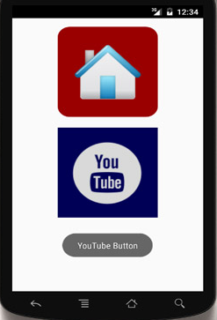
Activity_main.XML file
<ImageButton android:id="@+id/simpleImageButtonHome" android:layout_width="wrap_content" android:layout_height="wrap_content" android:layout_centerHorizontal="true" android:background="@drawable/custom_image_button" android:padding="20dp" android:src="@mipmap/ic_launcher" /> <ImageButton android:id="@+id/simpleImageButtonYouTube" android:layout_width="wrap_content" android:layout_height="wrap_content" android:layout_below="@+id/simpleImageButtonHome" android:layout_centerHorizontal="true" android:layout_marginTop="20dp" android:background="#005" android:padding="20dp" android:src="@drawable/ic_launcher_foreground" />

Slide 41
ImageButton ButtonHome = (ImageButton)findViewById(R.id.simpleImageButtonHome);
ImageButton ButtonYouTube = (ImageButton)findViewById(R.id.simpleImageButtonYouTube);
// display the toast on home button click
ButtonHome.setOnClickListener(new View.OnClickListener() {
@Override
public void onClick(View view) { Toast.makeText(getApplicationContext(),"Home Button",Toast.LENGTH_LONG).show();
} });
// display the toast on you tube button click

Slide 42
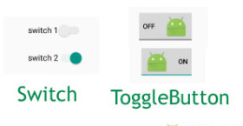
Toggle Button
The ToggleButton is useful for the users to change the settings between two states either ON or OFF.
Toggle Button is a user interface control which is used to display ON (Checked) or OFF (Unchecked) states as a button with a light indicator.
The most simple example of ToggleButton is doing on/off in sound, Bluetooth, wifi, hotspot etc.
Android 4.0 version ( API level 14 ) there is an another kind of ToggleButton called Switch which provide the user slider control.
WiFi
Bluetooth

Slide 43
Toggle Attributes
android:checked : It is used to specify the current state of toggle button
android:text : It is used to set the text.
android:textOn: It is used to set the text when toggle button is in ON / Checked state.
android:textOff : It is used to set the text when toggle button is in OFF / Unchecked state.
android:drawableBottom:
android:drawableTop:
android:drawableRight
android:drawableLeft:

Slide 44
Create ToggleButton in XML Layout File
<ToggleButton android:id="@+id/toggle1" android:layout_width="wrap_content" android:layout_height="wrap_content" android:layout_marginLeft="100dp" android:layout_marginTop="120dp" android:checked="true" android:textOff="OFF" android:textOn="ON"/>
Create ToggleButton Control in JAVA
RelativeLayout layout = (RelativeLayout)findViewById(R.id.r_layout); ToggleButton tb = new ToggleButton(this); tb.setTextOff("OFF"); tb.setTextOn("ON"); tb.setChecked(true); layout.addView(tb);

Slide 45
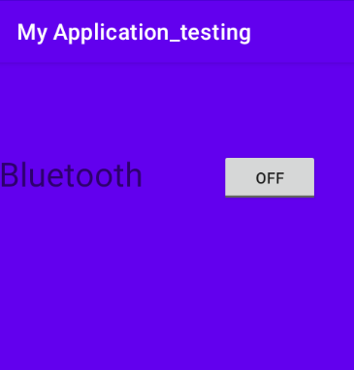
Bluetooth is in ON or OFF
<RelativeLayout>
<TextView
android:id="@id/txt"
android:layout_width="200dp"
android:layout_height="wrap_content"
android:text="Bluetooth"
android:textSize="30dp"
android:layout_marginTop="80dp"/>
<ToggleButton
android:id="@+id/toggleButton"
android:layout_width="wrap_content"
android:layout_height="wrap_content"
android:layout_toRightOf="@+id/txt"
android:layout_marginTop="80dp"
android:textOff="Off"
android:textOn="On"
/>
</RelativeLayout>

Slide 46
ToggleButton toggle = (ToggleButton) findViewById(R.id.togglebutton);
//Checked Event , CompoundButton is a class calling OnCheckedChangeListener() method toggle.setOnCheckedChangeListener(new CompoundButton.OnCheckedChangeListener() {
public void onCheckedChanged(CompoundButton buttonView, boolean isChecked) { if (isChecked) { Toast.makeText(getApplicationContext(),”Bluetooth ON” ,Toast.LENGTH_LONG).show(); } else { Toast.makeText(getApplicationContext(),”Bluetooth OFF” ,Toast.LENGTH_LONG).show(); } } });

Slide 47
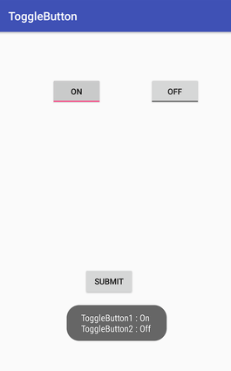
Toggle Button Example1 .XML code
<ToggleButton android:id="@+id/toggleButton1" android:layout_width="wrap_content" android:layout_height="wrap_content" android:layout_marginLeft="8dp" android:layout_marginTop="80dp" android:text="ToggleButton" android:textOff="Off" android:textOn="On“ /> <ToggleButton android:id="@+id/toggleButton2" android:layout_width="wrap_content" android:layout_height="wrap_content" android:layout_marginRight="60dp" android:layout_marginTop="80dp" android:text="ToggleButton" android:textOff="Off" android:textOn="On“ />
Bluetooth
WiFi

Slide 48
<Button android:id="@+id/button" android:layout_width="wrap_content" android:layout_height="wrap_content" android:layout_marginBottom="144dp" android:layout_marginLeft="148dp" android:text="Submit“ />

Slide 49
Toggle Button Example1 .JAVA code
toggleButton1=(ToggleButton)findViewById(R.id.toggleButton);
toggleButton2=(ToggleButton)findViewById(R.id.toggleButton2);
buttonSubmit=(Button)findViewById(R.id.button);
//Performing action on button click
buttonSubmit.setOnClickListener(new View.OnClickListener(){
public void onClick(View view) {
Toast.makeText(getApplicationContext(), “Blutooth - " + toggleButton1.getText().toString() + " \n" + “WiFi - " + toggleButton2.getText().toString(),Toast.LENGTH_SHORT).show();

Slide 50
Use of string builder to display
//Getting the ToggleButton and Button instance from the layout xml file
toggleButton1=(ToggleButton)findViewById(R.id.toggleButton);
toggleButton2=(ToggleButton)findViewById(R.id.toggleButton2);
buttonSubmit=(Button)findViewById(R.id.button);
//Performing action on button click
buttonSubmit.setOnClickListener(new View.OnClickListener(){
public void onClick(View view) {
StringBuilder result = new StringBuilder(); // Creating object of class
result.append(“Bluetooth: ").append(toggleButton1.getText()); //method
result.append("\n WiFi : ").append(toggleButton2.getText());
//Displaying the message in toast
Toast.makeText(getApplicationContext(), result.toString(),Toast.LENGTH_LO NG).show();
}

Slide 51
Java StringBuilder class is used to create mutable (modifiable) string.
Constructors of StringBuilder class
StringBuilder append() method
The StringBuilder append() method concatenates the given argument with this string.
Constructor | Description
StringBuilder() | creates an empty string Builder with the initial capacity of 16.
StringBuilder(String str) | creates a string Builder with the specified string.
StringBuilder(int length) | creates an empty string Builder with the specified capacity as length.

Slide 52
Radio Button
Radio button is a widget which can have more than option to choose from and the user can choose only one option at a time. Where as Toggle button had exactly 2 states
Each option in this refers to a radio button and all the options together referred to as Radio Group.
By grouping them together, the system ensures that only one radio button can be selected at a time.
Hence, Radio buttons are used inside a Radio Group.
Radio Group Used for set of radio buttons.
If we check one radio button that belongs to a radio group , it automatically uncheck any previously checked button within the same group.

Slide 53
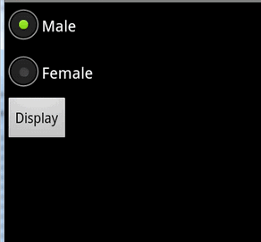
Radio Button Example 1
<RadioGroup
android:id="@+id/radioid“
android:layout_width="wrap_content" android:layout_height="wrap_content" >
<RadioButton android:id="@+id/radioMale" android:layout_width="wrap_content" android:layout_height="wrap_content"
android:text=“Male"
android:checked="true" />
<RadioButton android:id="@+id/radioFemale" android:layout_width="wrap_content" android:layout_height="wrap_content“
android:text=“Female" />
</RadioGroup>
<Button android:id="@+id/btnDisplay"
android:layout_width="wrap_content“
android:layout_height="wrap_content"
android:text=“Display" />

Slide 54
RadioGroup radiogenderGroup;
RadioButton radiogenderButton;
Button btnDisplay;
radiogenderGroup = (RadioGroup) findViewById(R.id.radioid);
btnDisplay = (Button) findViewById(R.id.btnDisplay);
btnDisplay.setOnClickListener(new OnClickListener() {
@Override
public void onClick(View v) {
// get selected radio button from radioGroup
int selectedId = radiogenderGroup.getCheckedRadioButtonId();
// find the radiobutton by returned id
radiogenderButton = (RadioButton) findViewById(selectedId);
Toast.makeText(MyAndroidAppActivity.this, radiogenderButton.getText().toString(), Toast.LENGTH_SHORT).show();

Slide 55
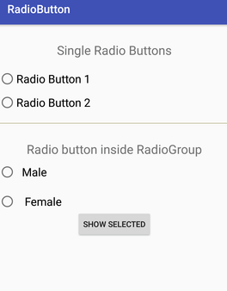
<TextView
android:id="@+id/textView1"
android:layout_width="fill_parent"
android:layout_height="wrap_content" Radio button Example 2
android:text="Single Radio Buttons" />
<RadioButton
android:id="@+id/radioButton1"
android:layout_width="fill_parent"
android:layout_height="wrap_content“
android:text="Radio Button 1" />
<RadioButton
android:id="@+id/radioButton2"
android:layout_width="fill_parent"
android:layout_height="wrap_content"
android:text="Radio Button 2" / >
<View android:layout_width="fill_parent" android:layout_height="1dp" android:layout_marginTop="20dp" android:background="#B8B894" /> <TextView android:id="@+id/textView2" android:layout_width="fill_parent" android:layout_height="wrap_content“ android:text="Radio button inside RadioGroup" />

Slide 56
<!-- Customized RadioButtons --> <RadioGroup android:layout_width="wrap_content" android:layout_height="wrap_content" android:id="@+id/radioGroup"> <RadioButton android:id="@+id/radioMale" android:layout_width="fill_parent" android:layout_height="wrap_content" android:text=" Male“ android:checked="false/> <RadioButton android:id="@+id/radioFemale" android:layout_width="fill_parent" android:layout_height="wrap_content" android:text=" Female“ android:checked="false" /> </RadioGroup> <Button android:layout_width="wrap_content" android:layout_height="wrap_content" android:text="Show Selected" android:id="@+id/button” />

Slide 57
To Toast radio button and gender radio button
Button button1; RadioButton rd1, rd2 , genderradioButton; RadioGroup radioGroup;
//create id of radio button (of without radio group)
rd1=(RadioButton) findViewById(R.id.radioButton1);
rd2=(RadioButton) findViewById(R.id.radioButton2);
radioGroup=(RadioGroup)findViewById(R.id.radioGroup); button1=(Button)findViewById((R.id.button));
button1.setOnClickListener(new View.OnClickListener() { @Override public void onClick(View v) {
//get id of selected radio button under radio group int selectedId = radioGroup.getCheckedRadioButtonId();
genderradioButton = (RadioButton) findViewById(selectedId); if(selectedId==-1 ){ Toast.makeText(radio_example1.this, "Nothing selected", Toast.LENGTH_SHORT).show(); }

Slide 58
//toast all radio button text
else if (rd1.isChecked()){
String str=“you have selected”;
str+=“\n” +rd1.getText().toString();
Toast.makeText(radio_example1.this,str +”\n” +genderradioButton.getText(), Toast.LENGTH_SHORT).show();
}
Else{
String str=“you have selected”;
Str+=“\n” +rd2.getText().toString();
Toast.makeText(radio_example1.this,str +”\n” +genderradioButton.getText(), Toast.LENGTH_SHORT).show();
}

Slide 59
Toast on radio button click(user defined function: onRadioButtonClicked
<RadioGroup
android:id="@+id/rd_group“
android:layout_width="wrap_content" android:layout_height="wrap_content" >
<RadioButton android:id="@+id/radioMale" android:layout_width="wrap_content" android:layout_height="wrap_content"
android:text=“Male“
android:onClick="onRadioButtonClicked"
android:checked="true" />
<RadioButton android:id="@+id/radioFemale“
android:layout_width="wrap_content“
android:layout_height="wrap_content“
android:onClick="onRadioButtonClicked"
android:text=“Female" />
</RadioGroup>
<Button android:id="@+id/btnDisplay"
android:layout_width="wrap_content“
android:layout_height="wrap_content"
android:text=“Display“
/>

Slide 60
public void onRadioButtonClicked(View view1) { boolean checked = ((RadioButton) view1).isChecked();
// Check which RadioButton is click switch(view1.getId()) { case R.id.radioMale: if (checked) Toast.makeText(MyAndroidAppActivity.this, “ Male is selected ”, Toast.LENGTH_SHORT).show();
break;
case R.id.radioFemale: if (checked) Toast.makeText(MyAndroidAppActivity.this, “Female is selected”, Toast.LENGTH_SHORT).show();
break; } }

Slide 61
Toast on radio button clickListener
<RadioButton android:id="@+id/radioMale" android:layout_width="wrap_content" android:layout_height="wrap_content"
android:text=“Male“
android:checked="true" />
<RadioButton android:id="@+id/radioFemale“
android:layout_width="wrap_content“
android:layout_height="wrap_content“
android:text=“Female" />
<Button android:id="@+id/btnDisplay"
android:layout_width="wrap_content“
android:layout_height="wrap_content"
android:text=“Display“
/>

Slide 62
RadioButton rdb1 = (RadioButton) findViewById(R.id.rdb1);
RadioButton rdb2 = (RadioButton) findViewById(R.id.rdb2);
rdb1.setOnClickListener(new View.OnClickListener() { @Override public void onClick(View v) { boolean checked = ((RadioButton) v).isChecked(); if (checked){ Toast.makeText(MyAndroidAppActivity.this, “Male is selected”, Toast.LENGTH_SHORT).show();
} else{ Toast.makeText(MyAndroidAppActivity.this, “Male is deselected”, Toast.LENGTH_SHORT).show(); } }

Slide 63
Check Box
Checkboxes allow the user to select one or more options from a set.
Attributes :
android:drawableBottom
This is the drawable to be drawn below the text.
android:drawableRight
This is the drawable to be drawn to the right of the text.

Slide 64
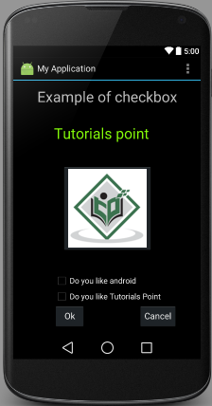
Check box example 1

Slide 65
<CheckBox android:id="@+id/checkBox1" android:layout_width="wrap_content" android:layout_height="wrap_content"
android:text="Do you like Tutorials Point“ />
<CheckBox android:id="@+id/checkBox2" android:layout_width="wrap_content" android:layout_height="wrap_content"
android:text="Do you like android "
android:checked="false“ />
<Button android:layout_width="wrap_content" android:layout_height="wrap_content"
android:text="Ok“
android:id="@+id/button1“ />
<Button android:layout_width="wrap_content" android:layout_height="wrap_content“
android:text="Cancel“
android:id="@+id/button2“ />

Slide 66
CheckBox ch1,ch2; Button b1,b2;
ch1=(CheckBox)findViewById(R.id.checkBox1); ch2=(CheckBox)findViewById(R.id.checkBox2); b1=(Button)findViewById(R.id.button1); b2=(Button)findViewById(R.id.button2);
b2.setOnClickListener(new View.OnClickListener()
{ @Override
public void onClick(View v) {
finish(); } });
b1.setOnClickListener(new View.OnClickListener()
{ @Override
public void onClick(View v) {
StringBuffer result = new StringBuffer();
If(ch1.isChecked()){
result.append("Thank: ") .append(ch1.getText());}
If(ch2.isChecked()){
result.append("\nThanks: ") .append(ch2.getText());}
Toast.makeText(MainActivity.this, result.toString(), Toast.LENGTH_LONG).show(); } });

Slide 67
public void onClick(View v) {
String str = “ selected languages are : “
If(ch1.isChecked()){
str +=ch1.getText.toString();}
If(ch2.isChecked()){
str +=ch2.getText.toString();}
Toast.makeText(MainActivity.this, result.toString(), Toast.LENGTH_LONG).show();

Slide 68
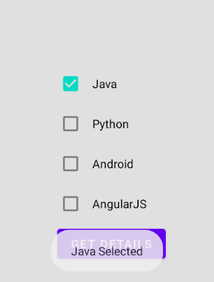
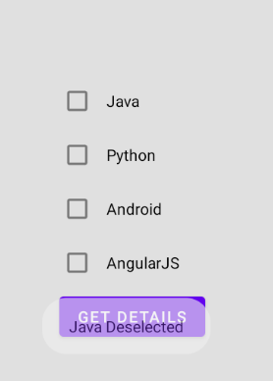
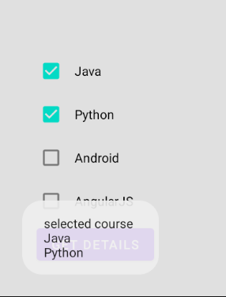
Exampe 2:Toast When CheckBox is Checked/UnChecked and also Toast All CheckBox on Button Click

Slide 69
<CheckBox
android:id="@+id/chkJava"
android:layout_width="wrap_content"
android:layout_height="wrap_content"
android:padding="10dp"
android:layout_marginTop="150dp"
android:layout_marginLeft="100dp"
android:text="Java"
android:onClick="onCheckboxClicked"/>

Slide 70
CheckBox android, java, angular, python;
android=(CheckBox)findViewById(R.id.chkAndroid); java=(CheckBox)findViewById(R.id.chkJava); angular=(CheckBox)findViewById(R.id.chkAngular); python=(CheckBox)findViewById(R.id.chkPython); Button btn=(Button)findViewById(R.id.getBtn); btn.setOnClickListener(new View.OnClickListener() { @Override public void onClick(View v) { String result="selected course"; if(android.isChecked()){ // if android checkbox is selected result+=android.getText(); // store the text of checkbox } if(angular.isChecked()){ result += "\nAngular"; } if(java.isChecked()){ result += "\nJava"; } if(python.isChecked()){ result += "\nPython"; } Toast.makeText(getApplicationContext(), result, Toast.LENGTH_SHORT).show(); } ); }

Slide 71
// when checbox is clicked user defined function is called public void onCheckboxClicked(View view1) { // refer all checkbox view by view1 boolean checked =((CheckBox)view1).isChecked(); // store the status of checkbox String str=""; // Check which checkbox is clicked switch(view1.getId()) { // get id of checkbox case R.id.chkAndroid:
str = checked?"Android Selected":"Android Deselected"; // if checked boolean is true means checbox is selected break; case R.id.chkAngular: str = checked?"AngularJS Selected":"AngularJS Deselected"; break; case R.id.chkJava: str = checked?"Java Selected":"Java Deselected"; break; case R.id.chkPython: str = checked?"Python Selected":"Python Deselected"; break; } Toast.makeText(getApplicationContext(), str, Toast.LENGTH_SHORT).show();

Slide 72
public void onCheckboxClicked(View view1) {
Checkbox c1=(CheckBox) findViewById(R.id.checkbox);
Checkbox c2=(CheckBox) findViewById(R.id.checkbox);
Checkbox c3=(CheckBox) findViewById(R.id.checkbox);
boolean checked =((CheckBox)view1).isChecked();
String str=""; switch(view1.getId()) { case R.id.chkAndroid:
str = checked?c1.getText().toString() + “is Selected": c1.getText().toString() + “is Deselected"; break;
case R.id.chkAngular: str = checked? c2.getText().toString() + “is Selected": c2.getText().toString() + “is Deselected"; break; } Toast.makeText(getApplicationContext(), str, Toast.LENGTH_SHORT).show();

Slide 73
Adapter
An adapter actually bridges between UI components and the data source that fill data into UI Component.
Adapter holds the data and send the data to adapter view,
The ListView and GridView are subclasses of AdapterView.
The common adapters are ArrayAdapter,Base Adapter, CursorAdapter, SimpleCursorAdapter,

Slide 74
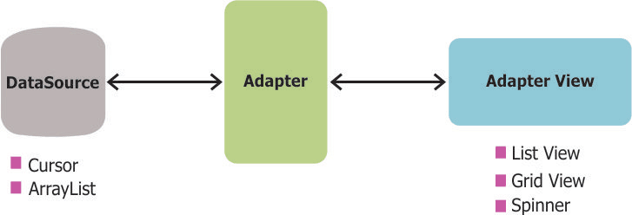
Adapter
ArrayAdapter links the array to the Adapter View. We use it when our data source in an array.
CursorAdapter when we have data in Cursor e.g when we get data from database.

Slide 75
ArrayAdapter
You can use this adapter when your data source is an array.
By default, ArrayAdapter creates a view for each array item and placing the contents in a TextView.
Syntax :
ArrayAdapter adapter 1= new ArrayAdapter<String>(this, R.layout.ListView, StringArray);
First argument this is the application context. Most of the case, keep it this.
Second argument will be layout defined in XML file and having TextView for each string in the array.
Final argument is an array of strings which will be populated in the text view.

Slide 76
List View
Android ListView is a view which groups several items and display them in vertical scrollable list.
The list items are automatically inserted to the list using an Adapter that pulls content from a source such as an array
or database.

Slide 77
List View Attributes
android:divider
This is drawable or color to draw between list items.
android:dividerHeight
This specifies height of the divider.
android:footerDividersEnabled
When set to false, the ListView will not draw the divider before each footer view. The default value is true.
android:headerDividersEnabled
When set to false, the ListView will not draw the divider after each header view. The default value is true.
listSelector: listSelector property is used to set back color of selected item
To add header view : ListView.addHeaderView(View)

Slide 78
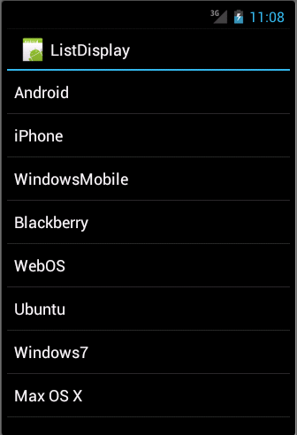
List View Example 1

Slide 79
List View Example
res/layout/activity_main.xml file
<LinearLayout >
<ListView
android:id="@+id/mobile_list"
android:layout_width="match_parent" android:layout_height="wrap_content" > </ListView>
</LinearLayout>
res/layout/activity_listview_textview.xml
<TextView >
android:id="@+id/label“
android:layout_width="fill_parent"
android:layout_height="fill_parent“
android:padding="10dp"
android:textSize="16dp"
android:textStyle="bold" > </TextView>

Slide 80
List view example .Java code
// Array of strings...
String[] mobileArray = {"Android","IPhone","WindowsMobile","Blackberry", "WebOS","Ubuntu","Windows7","Max OS X"};
@Override
protected void onCreate(Bundle savedInstanceState) { super.onCreate(savedInstanceState); setContentView(R.layout.activity_main);
//data bind listview with ArrayAdapter
ArrayAdapter adapter1 = new ArrayAdapter<String>(this, R.layout.activity_listview_textview, mobileArray);
ListView listView1 = (ListView) findViewById(R.id.mobile_list); listView1.setAdapter(adapter1);

Slide 81
listView1.setOnItemClickListener(new adapterView.OnItemClickListener() {
public void onItemClick(AdapterView parent, View v, int position, long id) {
// To hide listview : parent.setVisibility(View.GONE);
//The position is the position of the view in the parent ( row number).
// id is location of items…
//The View refers to a specific item within the AdapterView
if(position==0) {
Toast.makeText(MainActivity.this, "you have selected first option ", Toast.LENGTH_SHORT).show();
Toast.makeText(getApplicationContext(), ((TextView) v).getText(), Toast.LENGTH_SHORT).show(); }
elseif(position==1) { Toast.makeText(MainActivity.this, "you have selected second option ", Toast.LENGTH_SHORT).show();
Toast.makeText(getApplicationContext(), ((TextView) v).getText(), Toast.LENGTH_SHORT).show(); }

Slide 82
Grid View
In android GridView is a view group that display items in two dimensional scrolling grid (rows and columns), the grid items are not necessarily predetermined but they are automatically inserted to the layout using a ListAdapter.
An example of GridView is your default Gallery, where you have number of images displayed using grid.
Adapter Is Used To Fill Data In Gridview: To fill the data in a GridView we simply use adapter and grid items are automatically inserted to a GridView using an Adapter which pulls the content from a source such as an array.

Slide 83
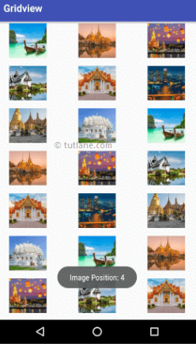
Grid View

Slide 84
Grid View Attributes
numColumns: numColumn define how many columns to show. It may be a integer value, such as “5” or auto_fit.:is used to display as many columns as possible to fill the available space on the screen.
verticalSpacing: verticalSpacing property used to define the default vertical spacing between rows.
columnWidth: columnWidth property specifies the fixed width of each column.
android:horizontalSpacing
Defines the default horizontal spacing between columns.
listSelector : listSelector property which define color for selected item.
android:stretchMode
Defines how columns should stretch to fill the available empty space, if any. This must be either of the values −
none − Stretching is disabled.
spacingWidth − The spacing between each column is stretched.
columnWidth − Each column is stretched equally.
spacingWidthUniform − The spacing between each column is uniformly stretched..

Slide 85
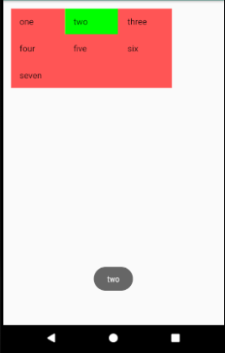
Grid View Example
<GridView android:id="@+id/grid_view" android:layout_width="300dp" android:layout_height="wrap_content" android:numColumns="3" android:verticalSpacing="2dp" android:horizontalSpacing="2dp" android:background="#ff5555" android:columnWidth="75dp" android:layout_margin="15dp" android:listSelector="#0f0"/>
res/layout/activity_listview_textview.xml
<TextView xmlns:android="http://schemas.android.com/apk/res/android" android:id="@+id/label“
android:layout_width="fill_parent"
android:layout_height="fill_parent“
android:padding="10dp"
android:textSize="16dp"
android:textStyle="bold" > </TextView>

Slide 86
Grid view example .java code
String[] array = {"one","two","three","four","five","six","seven"};
//initializing an ArrayList from array //refer GridView from xml layout file GridView gridview1 = (GridView) findViewById(R.id.grid_view);
//data bind GridView with ArrayAdapter ArrayAdapter<String> adapter = new ArrayAdapter<String>(this, android.R.layout. activity_listview_textview, array);
gridview1.setAdapter(adapter); gridview1.setOnItemClickListener(new AdapterView.OnItemClickListener() { @Override public void onItemClick(AdapterView parent , View view, int position, long id) { Toast.makeText(getApplicationContext(),((TextView) view).getText(), Toast.LENGTH_LONG).show(); }

Slide 87
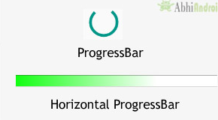
Progress Bar
android progress bar dialog box to display the status of work being done e.g. downloading file, analyzing status of work etc.
Indeterminate mode: This mode is used in application when we don’t know the amount of work to be done.
In this mode a progress bar shows a cyclic animation without an indication of progress.
setProgressStyle:
ProgressDialog.STYLE_HORIZONTAL
ProgressDialog.STYLE_SPINNER

Slide 88
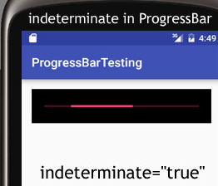
Attributes of Progress Bar
max: max is an attribute used in android to define maximum value of the progress can take.
progress: progress is an attribute used in android to define the default progress value between 0 and max.
progressDrawable: progress drawable is an attribute used in Android to set the custom drawable for the progress mode.
background: background attribute is used to set the background of a Progress bar. We can set a color or a drawable in the background of a Progress bar.
indeterminate: indeterminate attribute is used in Android to enable the indeterminate mode.
In this mode a progress bar shows a cyclic animation without an indication of progress. This mode is used in application when we don’t know the amount of work to be done. In this mode the actual working will not be shown..
use the Determinate progress mode in progress bar when we want to show the quantity of progress has occurred. For example, the percentage of file downloaded, number of records inserted into a database, etc.

Slide 89
Methods Used In Progress Bar
getMax() :returns the maximum value of progress bar.
setMax() : sets the max value for the Progress
getProgress() : returns current progress value.
setProgress(): update the Progress Dialog with some particular values
incrementProgressBy() : increment the progress bar by value.
setIndeterminate() : The progress indicator can either be set as determinate or indeterminate . It accepts either true or false.
progressBar.setCancelable(true);//you can cancel it by pressing back button.
progressBar.setMessage("File downloading ...");
progressBar.setProgressStyle(ProgressDialog.STYLE_HORIZONTAL);
progressBar.setProgressStyle (ProgressDialoge.STYLE_SPINNER);

Slide 90
public class progressbar_example extends AppCompatActivity { ProgressBar pgsBar; private int progress = 0; TextView txtView; @Override protected void onCreate(Bundle savedInstanceState) { super.onCreate(savedInstanceState); setContentView(R.layout.activity_progressbar_example1); pgsBar = (ProgressBar) findViewById(R.id.pBar); txtView = (TextView) findViewById(R.id.tView); Button btn = (Button) findViewById(R.id.btnShow); btn.setOnClickListener(new View.OnClickListener() { @Override public void onClick(View v) { // call a function setProgressValue(progress); } }); }

Slide 91
private void setProgressValue(final int progress) {
// set the progress
pgsBar.setProgress(progress);
// thread is used to change the progress value
Thread thread = new Thread(new Runnable() {
@Override
public void run()
{
try {
thread.sleep(1000); }
catch (InterruptedException e) {
e.printStackTrace(); }
setProgressValue(progress + 10);
}
});
thread.start();
}

Slide 92
Scroll View
useful to add a vertical or horizontal scroll bars to the content which is larger than actual size of layouts.
In android, ScrollView supports only vertical scrolling.
To implement horizontal scrolling, then we need to use HorizontalScrollView component.

Slide 93
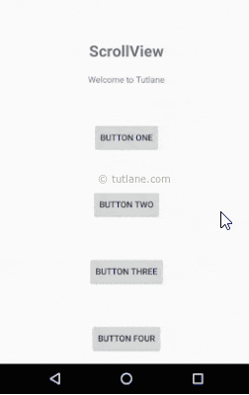
<ScrollView >
<LinearLayout>
<TextView android:id="@+id/loginscrn" android:layout_width="wrap_content" android:layout_height="wrap_content" android:text="ScrollView“ / > <Button android:layout_width="wrap_content" android:layout_height="wrap_content" android:layout_gravity="center“ android:text="Button One" />
<Button android:layout_width="wrap_content" android:layout_height="wrap_content" android:layout_gravity="center“ android:text="Button Two" />
< / LinearLayout>
< / ScrollView >

Slide 94
Layout Inflater
Inflate : to make something increase in size
There are two ways to create UI in android. One is static way and another is dynamic or programmatically.
Dynamic way of creating a view means the view is not mentioned in our main.xml but we want to show this in run time.
Eg : we inflate air in a balloon with an air pump to give it a shape,
similarly we can inflate different views like button, edit text etc through Java code(programmatically) with the help of Layout Inflater.
LayoutInflater is mainly used when we have to make our layout dynamically otherwise we can always make static views in XML.

Slide 95
Toast
Toast is used when we required to notify user about an operation without expecting any user input. It displays a small popup for message and automatically fades out after timeout.
Methods of Toast :
1.makeText(Context context, CharSequence text, int duration): This method is used to initiate the Toast. This method take three parameters First is for the application Context, Second is text message and last one is duration for the Toast.
2. show(): This method is used to display the Toast on the screen.
Limitation :
display information for a period of time.
It contains a message to be displayed quickly and disappears after specified period of time.
It does not block the user interaction.

Slide 96
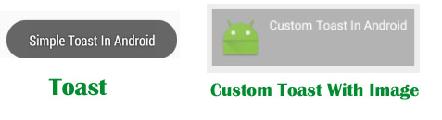
Custom Toast
In android, we can customize the layout of our toast notification to change the appearance based on requirements like include images in toast notification or change the background color of toast notification, etc.

Slide 97
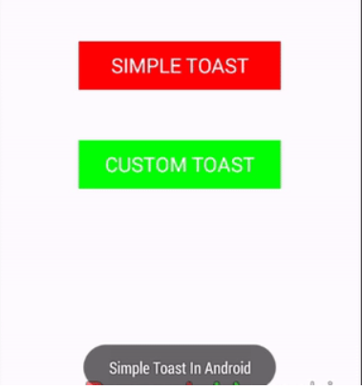
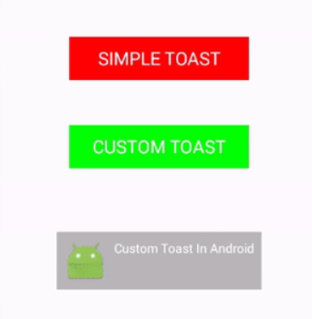
Mainactivity Example of Custom Toast
<!-- Button's for simple and custom Toast --> <Linearlayout>
<Button android:id="@+id/simpleToast" android:layout_width="200dp" android:layout_height="wrap_content“ android:text="Simple Toast" android:textColor="#fff" android:textSize="20sp" /> <Button android:id="@+id/customToast" android:layout_width="200dp" android:layout_height="wrap_content“ android:background="#0f0" android:text="Custom Toast" android:textColor="#fff" android:textSize="20sp" />
</linearlayout>

Slide 98
Custom.xml (inflated layout)
<LinearLayout xmlns:android="http://schemas.android.com/apk/res/android" android:id="@+id/custom_toast_layout“ // view group id android:orientation=“vertical" android:layout_width="match_parent" android:layout_height="match_parent“ /> <ImageView android:layout_width="wrap_content" android:layout_height="wrap_content" android:id="@+id/custom_img"/>
<TextView android:id="@+id/txtvw" android:layout_width="wrap_content" android:layout_height="wrap_content“ />

Slide 99
Mainactivity . Java code
Button simpleToast, customToast;
// get the reference of Button's simpleToast = (Button) findViewById(R.id.simpleToast); customToast = (Button) findViewById(R.id.customToast);
// perform setOnClickListener event on simple Toast Button simpleToast.setOnClickListener(new View.OnClickListener() { @Override public void onClick(View v) { // initiate a Toast with message and duration Toast toast = Toast.makeText(getApplicationContext(), "Simple Toast In Android", Toast.LENGTH_LONG); toast.show(); // display the Toast

Slide 100
// perform setOnClickListener event on custom Toast Button customToast.setOnClickListener(new View.OnClickListener() { @Override public void onClick(View v) {
// created an instance of LayoutInflater LayoutInflater inflater = getLayoutInflater();
// The inflate() method: inflate the layout from xml and has two arguments first one is the resource layout (XML file) which we want to inflate, second is the ViewGroup to be the parent of the inflated layout. ie : linear layout id name (view group)
//First parameter is the layout resource ID and the second is the root View and this inflated layout will help us to find the View objects in the layout.
View layout = inflater.inflate(R.layout.custom,(ViewGroup) findViewById(R.id.custom_toast_layout)); // get the reference of TextView and ImageVIew from inflated layout TextView toastTextView = (TextView) layout.findViewById(R.id.txtvw);
ImageView toastImageView = (ImageView) layout.findViewById(R.id.custom_img);

Slide 101
// set the text in the TextView toastTextView.setText("Custom Toast In Android");
toastImageView.setImageResource(R.drawable.ic_launcher);
// create a new Toast using context Toast toast = new Toast(getApplicationContext()); toast.setDuration(Toast.LENGTH_LONG); toast.setView(layout); // set the view for the Toast. In this method we pass the inflated layout which we inflate using inflate() method. toast.show();

Slide 102
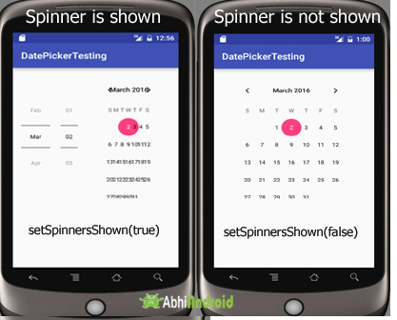
Date Picker
Android DatePicker widget is used to select date.

Slide 103
Attributes of DatePicker
DatePickerMode: This attribute is used to set the Date Picker in either spinner (Default mode ) or calendar mode.

Slide 104
Methods of DatePicker
1. setSpinnersShown(boolean shown):
This method is used to set whether the spinner of the date picker in shown or not. True indicates spinner is shown, false value indicates spinner is not shown. Default value is true.
Eg : DatePicker simpleDatePicker = (DatePicker)findViewById(R.id.simpleDatePicker);
// initiate a date picker
simpleDatePicker.setSpinnersShown(false); // set false value for the spinner
2. getDayOfMonth():
This method is used to get the selected day of the month from a date picker. This method returns an integer value.
Eg : DatePicker simpleDatePicker = (DatePicker) findViewById(R.id.simpleDatePicker);
// initiate a date picker
int day = simpleDatePicker.getDayOfMonth(); // get the selected day of the month

Slide 105
3. getMonth():
This method is used to get the selected month from a date picker.
4. getYear():
This method is used to get the selected year from a date picker.
5. getFirstDayOfWeek():
This method is used to get the first day of the week.

Slide 106
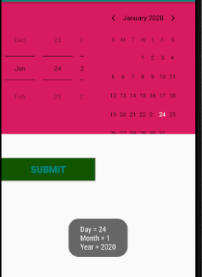
Date Picker example
<LinearLayout>
<DatePicker android:id="@+id/simpleDatePicker" android:layout_width="wrap_content" android:layout_height="wrap_content“ android:datePickerMode="spinner" /> <Button android:id="@+id/submitButton" android:layout_width="200dp“ android:text="SUBMIT“ />
</LinearLayout>

Slide 107
Date Picker .java code
DatePicker simpleDatePicker; Button submit;
// initiate the date picker and a button simpleDatePicker = (DatePicker) findViewById(R.id.simpleDatePicker); submit = (Button) findViewById(R.id.submitButton);
// perform click event on submit button submit.setOnClickListener(new View.OnClickListener() { @Override public void onClick(View v) {
// get the values for day of month , month and year from a date picker String day = "Day = " + simpleDatePicker.getDayOfMonth(); String month = "Month = " + (simpleDatePicker.getMonth() + 1); String year = "Year = " + simpleDatePicker.getYear();
// display the values by using a toast Toast.makeText(getApplicationContext(), day + "\n" + month + "\n" + year, Toast.LENGTH_LONG).show();

Slide 108
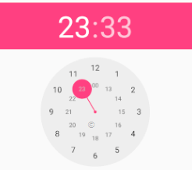
Time picker
It allows you to select time by hour and minute.
Two types of modes : Clock and Spinner
Attributes :
1.android : timePickerMode : to set mode. Default is spinner
Eg : android:timePickerMode="clock"
2. android:background : set the background color .
Methods :
getCurrentHour()
getCurrentMinute()
getCurrentTime

Slide 109
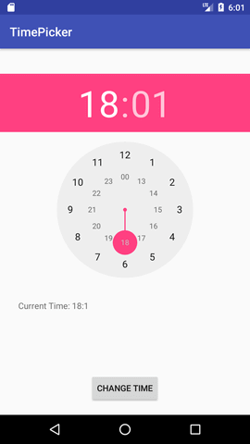
Time Picker
<TimePicker android:id="@+id/textview1" android:layout_width="wrap_content" android:layout_height="wrap_content" android:timePickerMode=“clock" android:layout_gravity="center" /> <Button
android:id="@+id/button1"
android:layout_width="wrap_content"
android:layout_height="wrap_content"
android:layout_marginBottom="20dp"
android:text="Change Time" />

Slide 110
protected void onCreate(Bundle savedInstanceState) {
super.onCreate(savedInstanceState);
setContentView(R.layout.activity_main);
textview1=(TextView)findViewById(R.id.textView1);
timepicker=(TimePicker)findViewById(R.id.timePicker);
//to display time in 24 hour format
timepicker.setIs24HourView(true);
changetime=(Button)findViewById(R.id.button1);
textview1.setText(getCurrentTime());
changetime.setOnClickListener(new View.OnClickListener(){
@Override
public void onClick(View view) {
textview1.setText(getCurrentTime());

Slide 111
To display hours and minute :
Button1.setOnClickListener(new View.OnClickListener() {
@Override
public void onClick(View view) {
textview1.setText(timepcker.getCurrentHour()+":"+timepcker.getCurrentMinute());
}
});

Slide 112
List any four attributes of check box. 2m
State syntax to create Text View and Image button with any two attributes of each. 4m
Write a program to demonstrate Date and Time picker. 4m
(Note: Consider the appropriate XML file. All attributes are not required.
In java file all imports are not expected. Different relevant logic/code can be considered.)
Write a program to convert temperature from celcius to farenhite and vice versa using Toggle button. (Design UI as per your choice. Write XML and java file) 6m
Explain Gridview with its attributes with suitable example. 4m
Design a employee registration form using UI component. 6m
Explain how linear and frame layout is used to design an android application with suitable example. 6m
(2 M : For each layout explanation, 1 M for each layout example )

